Slide 1

Interband Cascade Lasers: Current status and future work
Yuchao Jiang, PhD
2016.7.21

Slide 2
Outline
Motivation and background
Why interband cascade (IC) lasers?
State-of-the-art IC lasers at λ~3.7 μm
My work: InAs-based IC lasers
Single-mode DFB IC laser at λ=4.5 μm
CW operation above RT at λ=4.6-4.8 μm
Pulsed operation above RT at λ=6.2-6.7 μm
Electrically widely tunable IC laser near λ=7 μm
My work: GaSb-based type-I IC lasers
CW operation above RT at λ=3.2 μm
High-frequency operation consisting of type-I IC laser and IC detector
Future work and ideas
Achieve CW operation above RT at λ> 6μm
Fundamental physics of the carrier transport in injection region
Fundamental limits of T₀ in any interband lasers

Slide 3

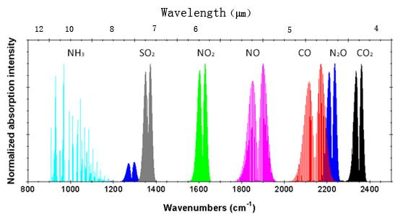
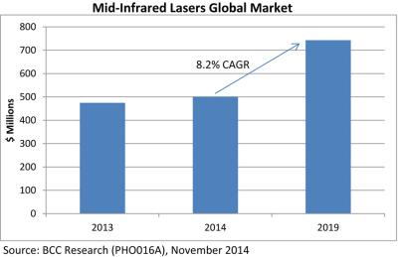
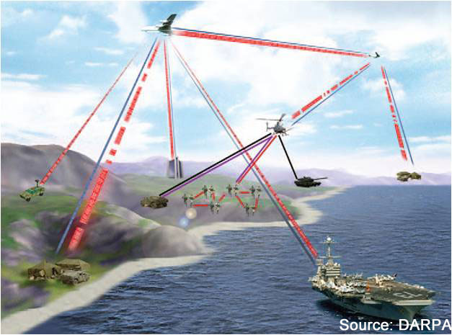
why interband cascade (IC) lasers?
Mid-IR: 3-8 μm; Long-IR: 8~15 μm
Applications:
Gas-sensing
Free space optical
communications
"Mars methane detection and variability at Gale crater", Science, 347, 415 (2015).
So far, IC laser is the most efficient laser source in mid-wave IR range.

Slide 4
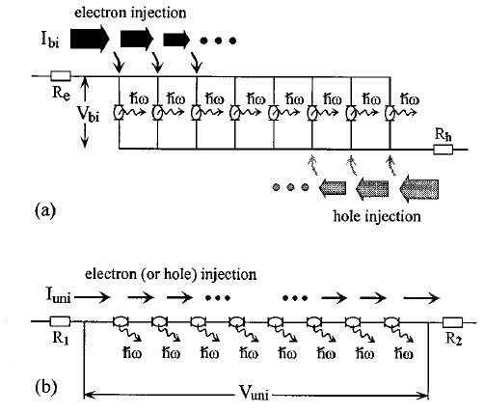

Why interband cascade (IC) lasers? vs. non-cascade interband lasers
Shared issues for any interband lasers:
free carrier absorption loss
Auger recombination dominates J_{th}(=e∙n_{th}/ τ)
Advantages of cascade structure :
reduce n_{th}-> reduce Auger
like power transmission line -> lower ohmic loss
R. Yang, S. Pei, J. Appl. Phys. 79,8197(1996)
 | type | equivalent circuit | key difference
a | MQW laser | in parallel | low voltage
b | IC laser | in series | low current
GaN LED in a cascade style overcame(?) efficiency droop.
F. Akyol, et al., Appl. Phys. Lett. 103,081107(2013)

Slide 5
Why interband cascade (IC) lasers? vs. quantum cascade (QC) lasers
Only two technologies capable of CW RT in mid-IR
 | QC laser | IC laser
material system | InGaAs/InAlAs/InP | InAs/GaSb/AlSb
carrier transition, lifetime | inter-subband, ~1 ps | interband, ~1 ns
threshold current density | 860 A/cm² @4.6μm | 100 A/cm² @3.6μm
threshold voltage | 12.8 V (40 stages) | 3 V (10 stages)
threshold power density | 11 kW/cm² | 0.3 kW/cm²
maximum output power | 5.1 W | 0.6 W
thermal conductivity | InP: 68 W/m∙K | GaSb:33; InAs:27
ref: APL, 95,141113 (2009) ; APL, 102,231123(2013)
APL, 89,181102 (2011); Opt Exp., 22,7702(2014)
IC laser is a better solution for battery powered applications.

Slide 6
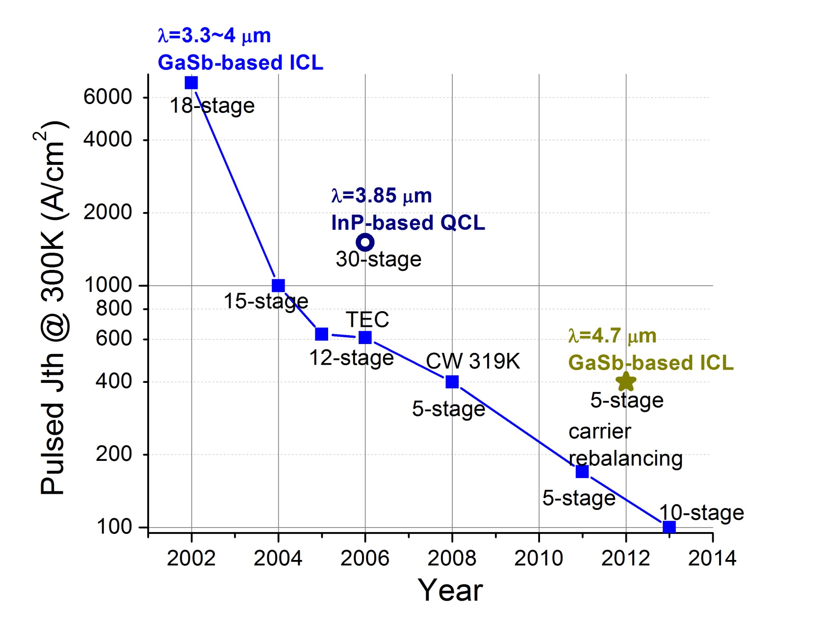
Snapshot of IC laser development
How the progress is made?
better material & fabrication
improved understanding & design
trial and error

Slide 7
Band structure of IC laser
bias
Design innovations since the prototype by R. Yang in 1994:
“W” like active region
2 QWs in hole injector
fine tune barrier thickness
semi-metallic interface
shortened electron injector
“carrier rebalancing”
(not fully understood)
“Rebalancing of internally generated carriers for mid-infrared interband cascade lasers with very low power consumption”,
Vurgaftman, et al., Nature Communication, 2, 585 (2011)

Slide 8
Waveguide structures of IC lasers
InAs/AlSb Superlattice Waveguide
InAs Plasmon-Enhanced Waveguide
Contact
Contact
InAs/AlSb SL
top cladding
InAs n⁺⁺
InAs Spacer
GaSb Spacer
Cascade Stages
n=3.45
Cascade Stages
n=3.45
GaSb Spacer
n=3.73
InAs Spacer
n=3.49
InAs/AlSb SL n=3.35
bottom
cladding
InAs n⁺⁺ n~3
GaSb Substrate
InAs Substrate
Material | Thermal Conductivity
InAs/AlSb SL | ~ 2.7 W/m·K
InAs | ~ 27 W/m·K
GaSb | ~ 33 W/m·K
Better thermal dissipation
Simplify the growth
Tunable refractive index
InAs-based IC lasers may be
a better solution at longer λ

Slide 9
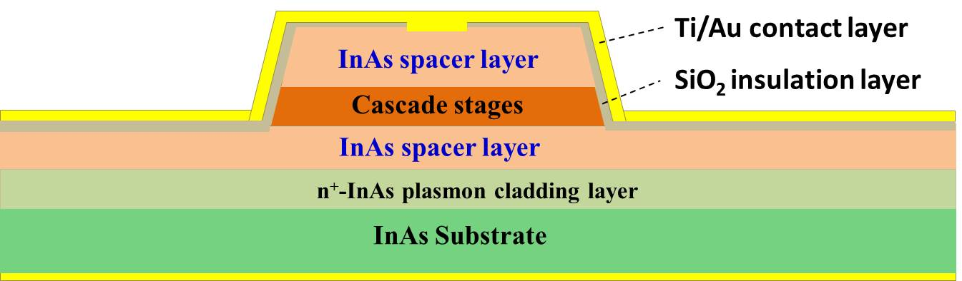
Why InAs-based IC lasers?
plasmon
frequency
doping
concentration
Drude model
tunable refractive index
-> flexible waveguide design
symmetric cladding
Contact
asymmetric cladding
further simplify growth
easier to fabricate top DFB grating
Plasmon cladding
InAs Spacer
Cascade Stages
n=3.45
InAs Spacer
n=3.49
InAs Plasmon cladding n~3
InAs Substrate

Slide 10
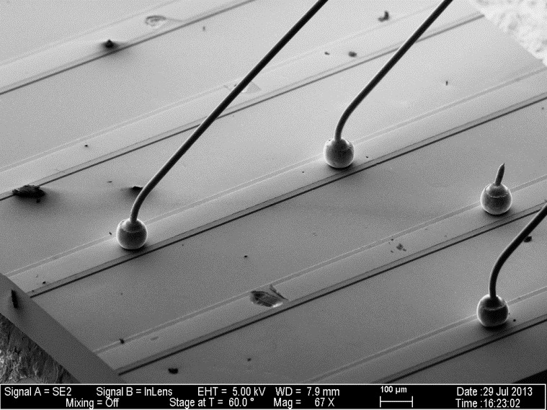
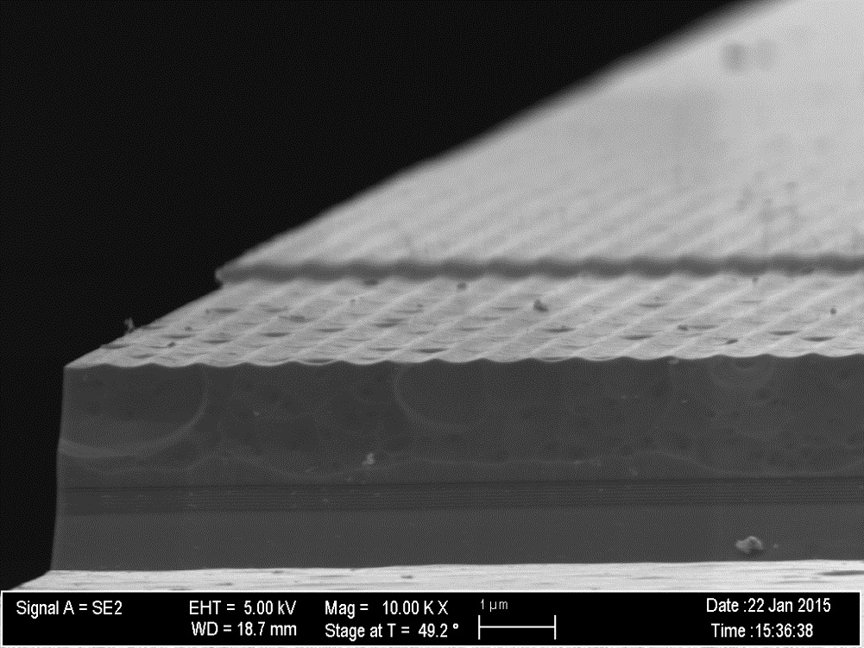
Real device & testing set-up
Laser
LN₂
Laser mesa
Trench
Current in
200 μm
Side
view
Temperature
Controller
Cryostat
Semiconductor grating
Vacuum
Top spacer
sensor A
Light
out
heater
Cascade stages
sensor B
Bottom spacer
1 μm

Slide 11
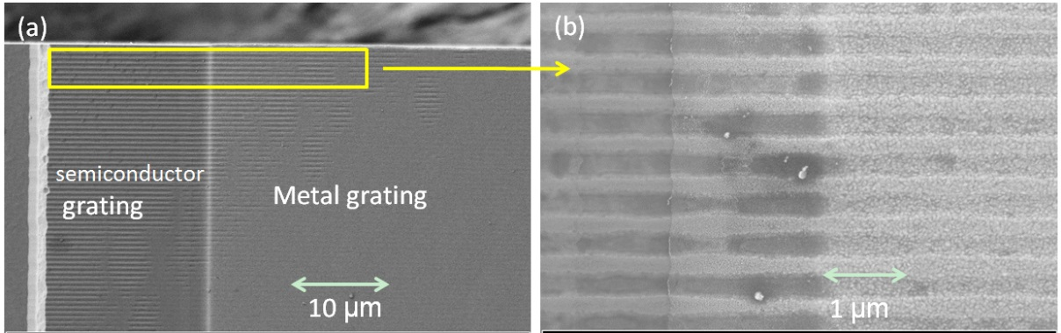
InAs-based Single-mode DFB IC laser
Single frequency-mode laser is desirable for gas-sensing
First DFB IC laser with an asymmetric waveguide
Y. Jiang, et al., IEEE J. Quantum Electron. 51, 2300307(2015)

Slide 12
Laser design by threshold analysis
Modal gain (measurable)
Material gain (unmeasurable)
Confinement factor
of Active QWs
End goal: minimize threshold:
Design approaches:
Active core optimization (future work)
Optical waveguide optimization (current work)

Slide 13
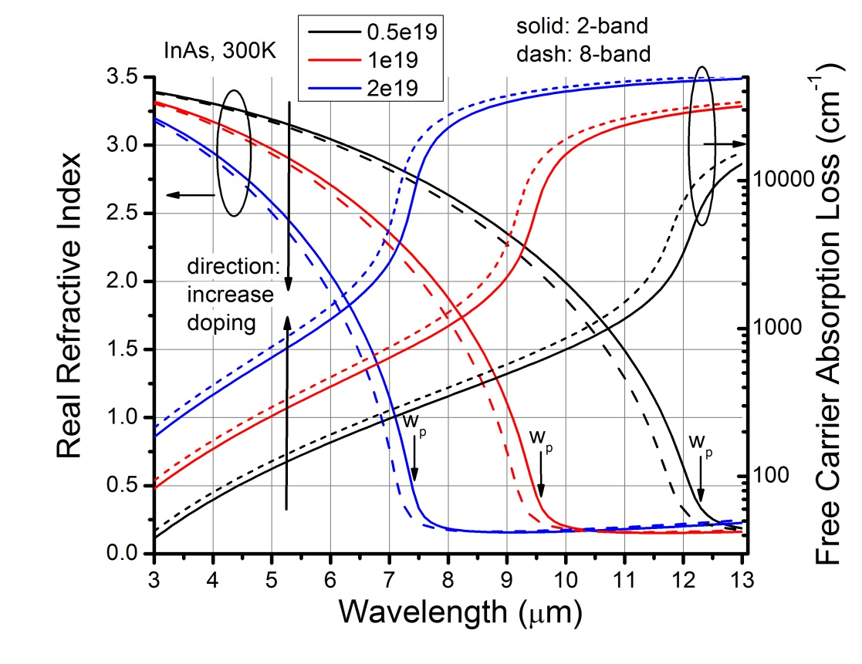
Optical waveguide optimization(1)
plasmon
frequency
doping
concentration
Drude model
When λ_{emission} near λ_{plasmon}:
n decreases sharply
loss increase exponentially

Slide 14
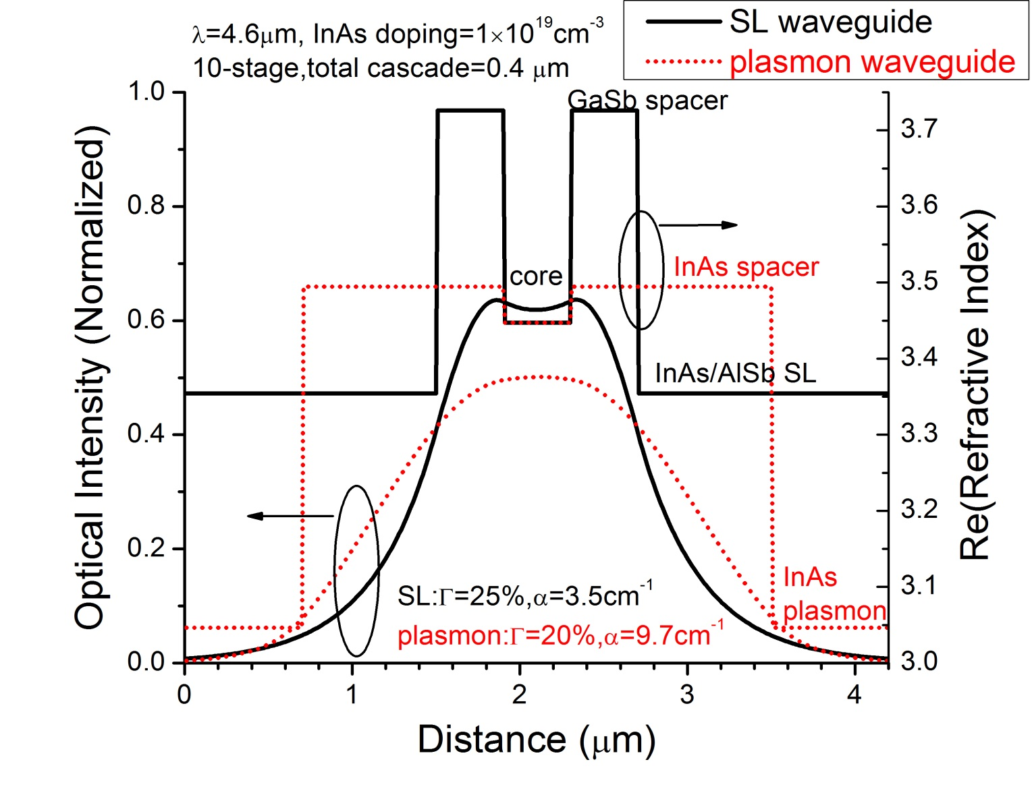
Optical waveguide optimization(2)
Plasmon waveguide
requires higher
material gain!

Slide 15
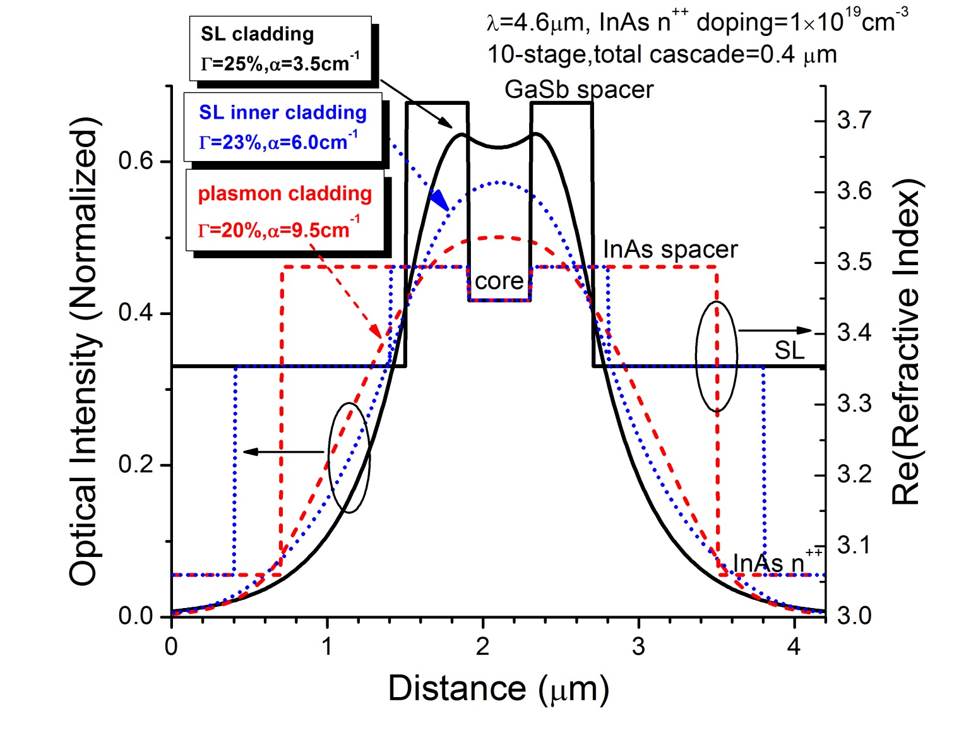
Optical waveguide optimization(3)
Hybrid waveguide:
InAs spacer layer
InAs/AlSb SL inner cladding
InAs plasmon outer cladding
Predict threshold gain
reduced by ~30%

Slide 16
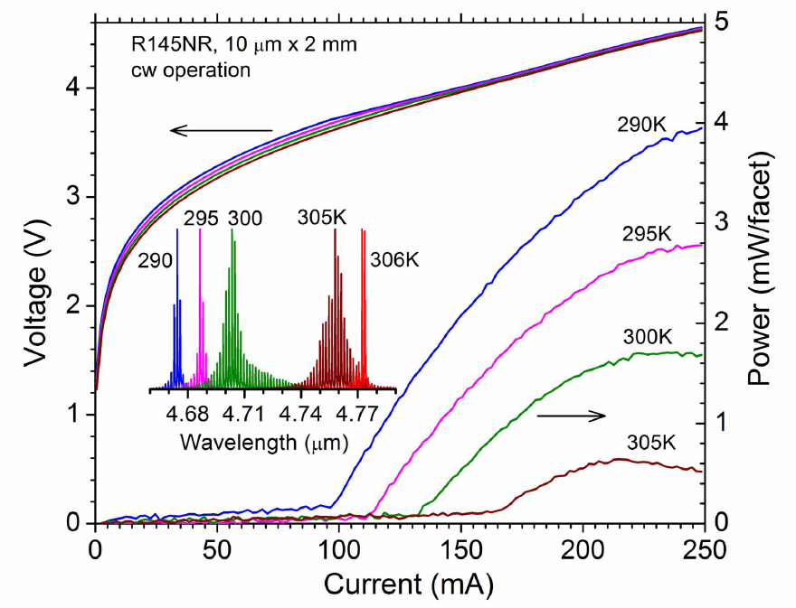
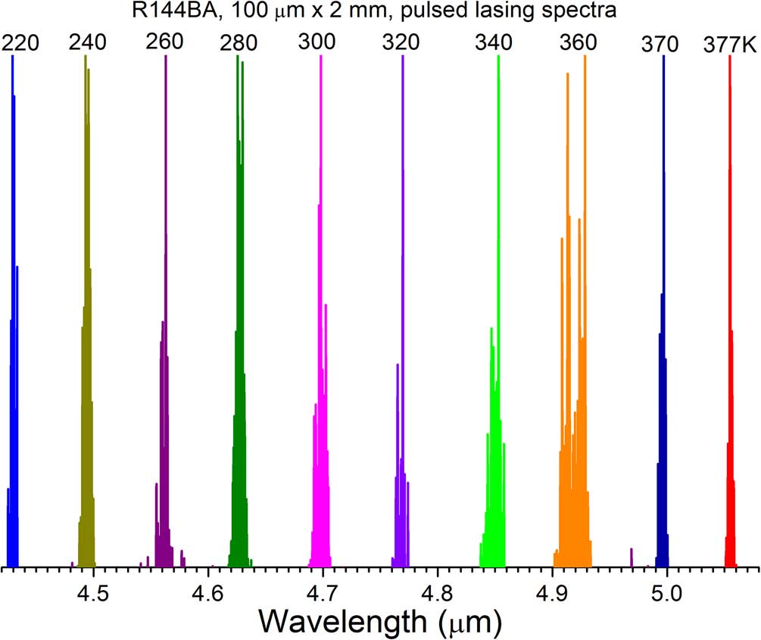
CW RT operation at λ=4.6-4.8 μm (1)
J_{th}: 670 A/cm² at 300 K
Voltage efficiency: ~70%
Input power: 0.5 W
Max T: 33 C in cw
Max pulsed operation
temperature: 377 K(~104 C)
L. Li, et al., Appl. Phys. Lett.,106, 251102(2015)

Slide 17
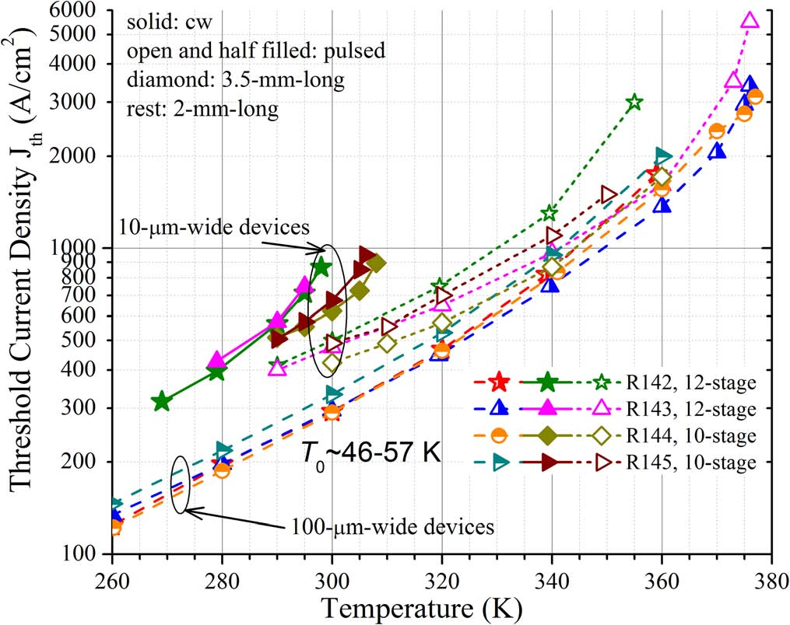
CW RT operation at λ=4.6-4.8 μm (2)
lowest J_{th} among diode lasers at similar wavelength
vs. R125 (lasers w/t hybrid wg):
up to 40% improvement
existing issues & future improvements:
NR device’s J_{th} ~50% larger than BA.
Better passivation to reduce leakage.
R_{sth}=6.5~11 Kcm²/kW, larger than 5.4 Kcm²/kW in GaSb-based IC laser.
Need to improve thermal dissipation.

Slide 18
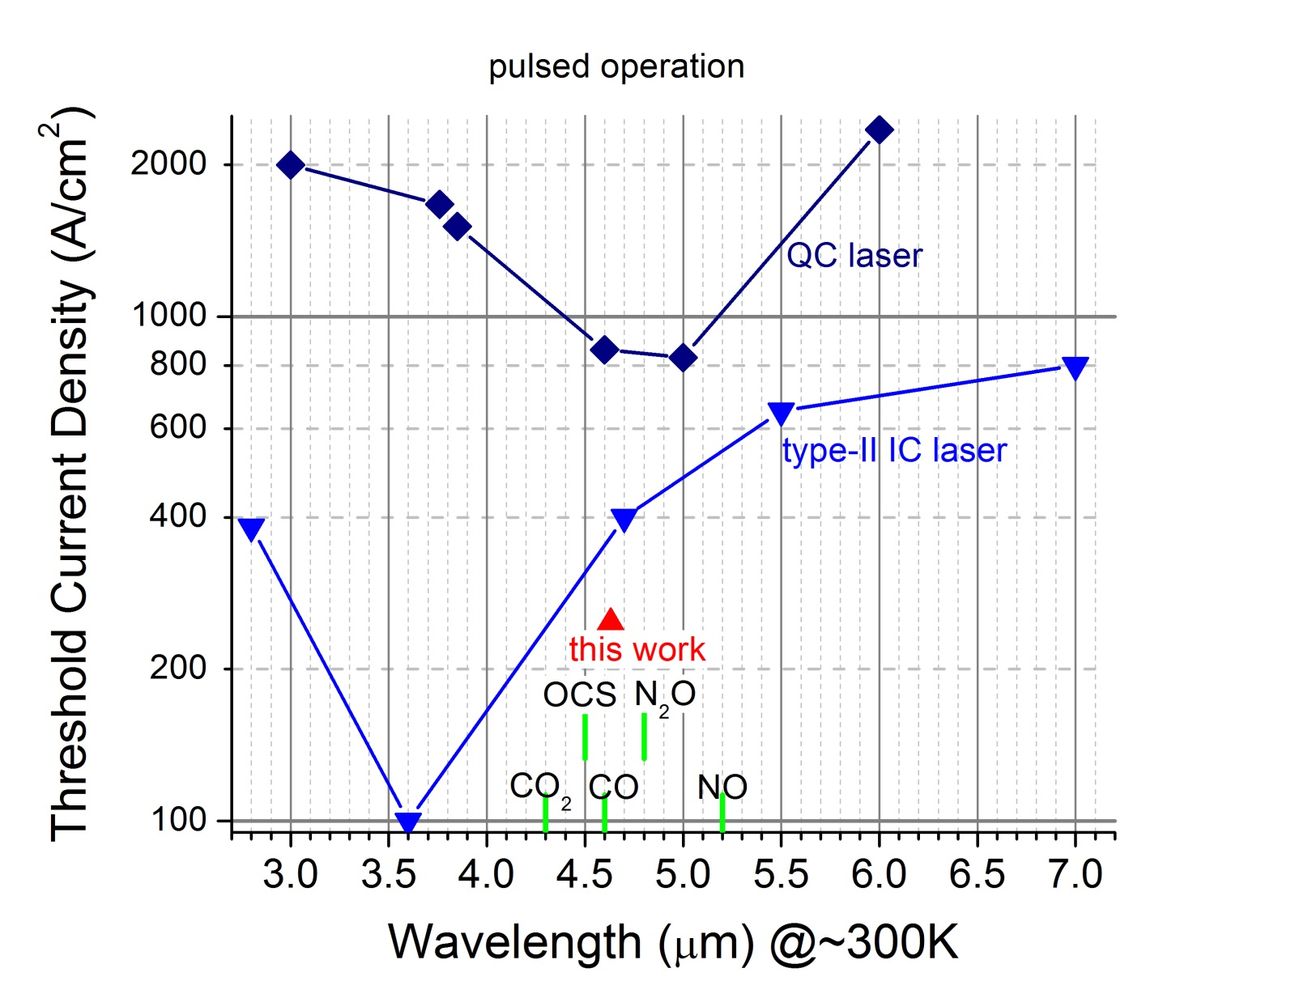
This work compare with others

Slide 19
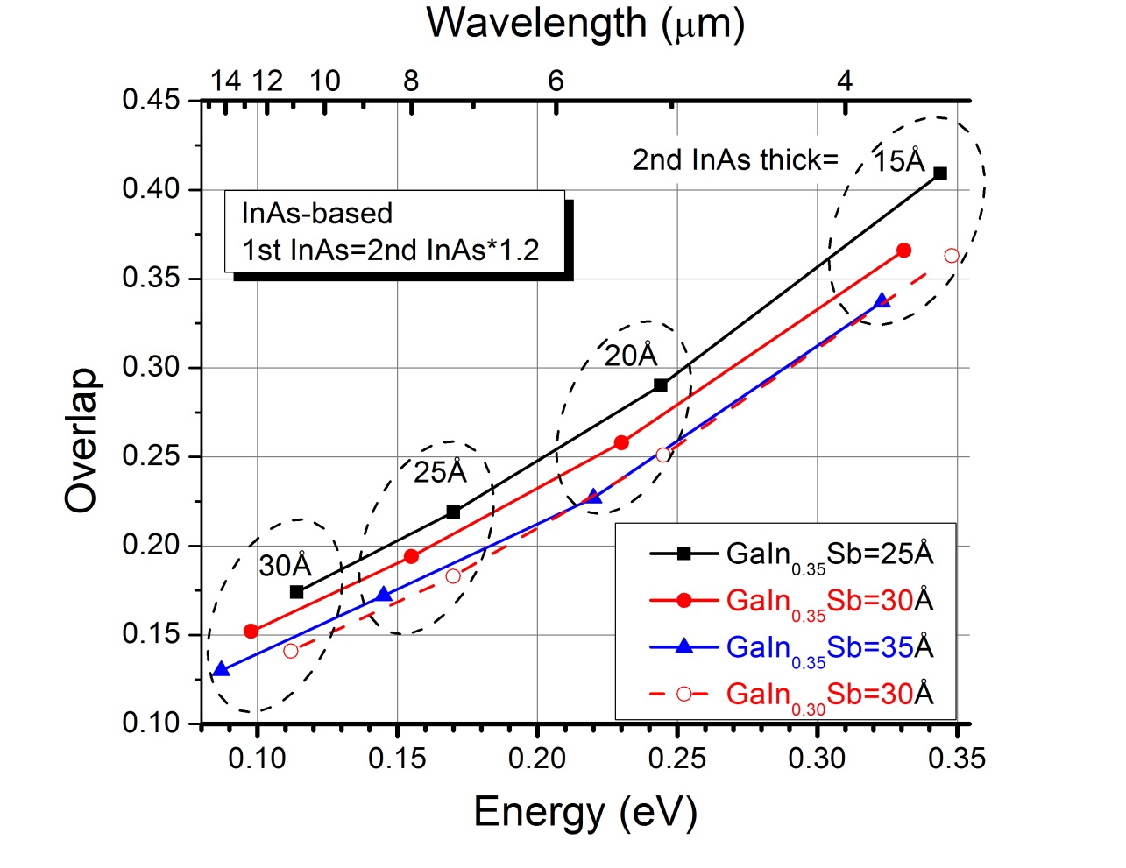
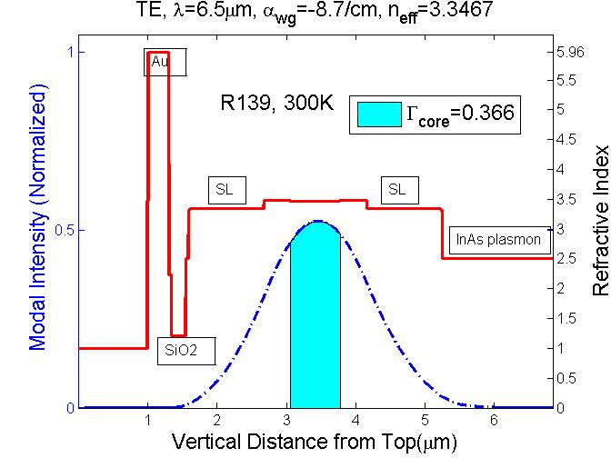
IC laser designed at λ=6.2-6.7 μm
Challenges | Solution
Reduced wavefunction overlap | new hole QW material ?
Reduced optical confinement | increase number of stages
Increased optical loss | hybrid waveguide, optimize doping

Slide 20
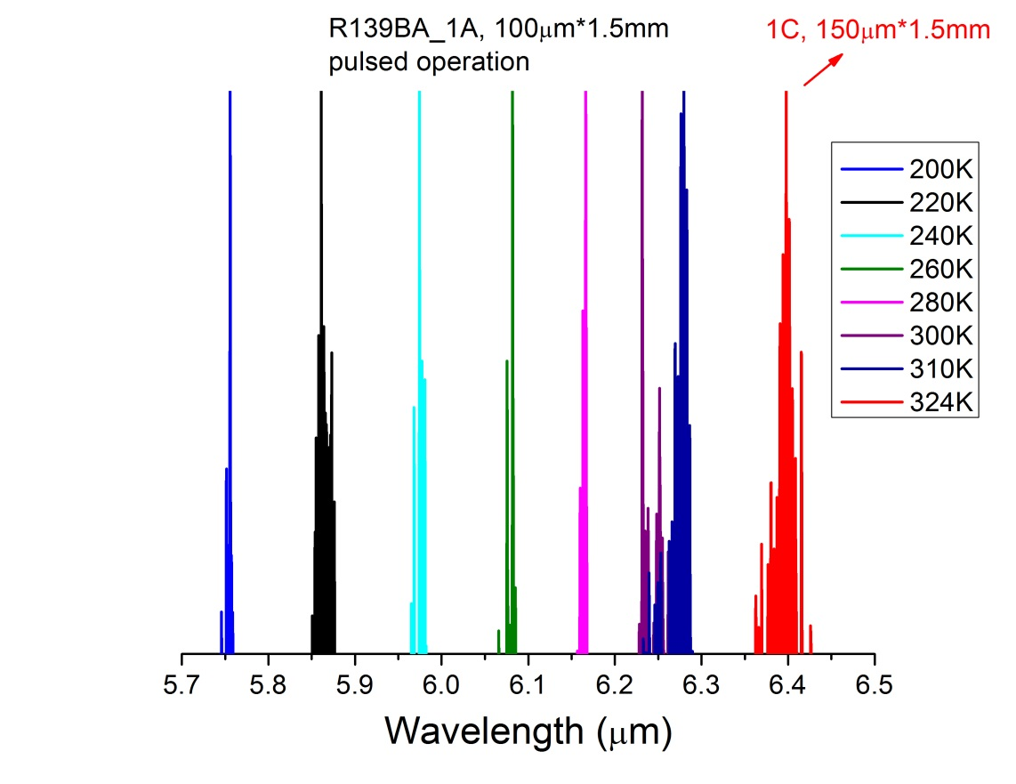
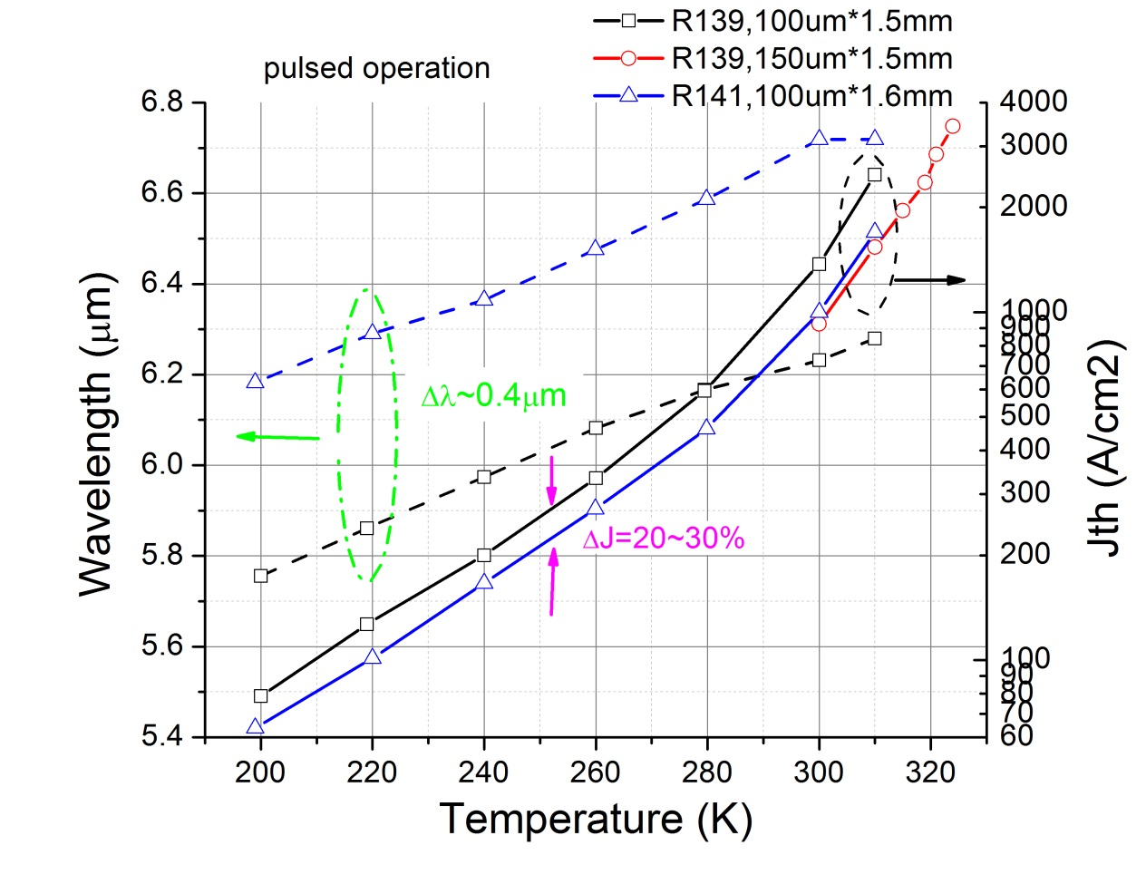
Pulsed RT operation at λ=6.2-6.7 μm
Results comparable to best IC lasers by a competing group
 | this work | SPIE,9550,0F(2015)
Pulsed J_{th} at 300K | 810 A/cm² (18 stages) | ~700 A/cm² (22 stages)
T₀ | 40 K | 41 K

Slide 21
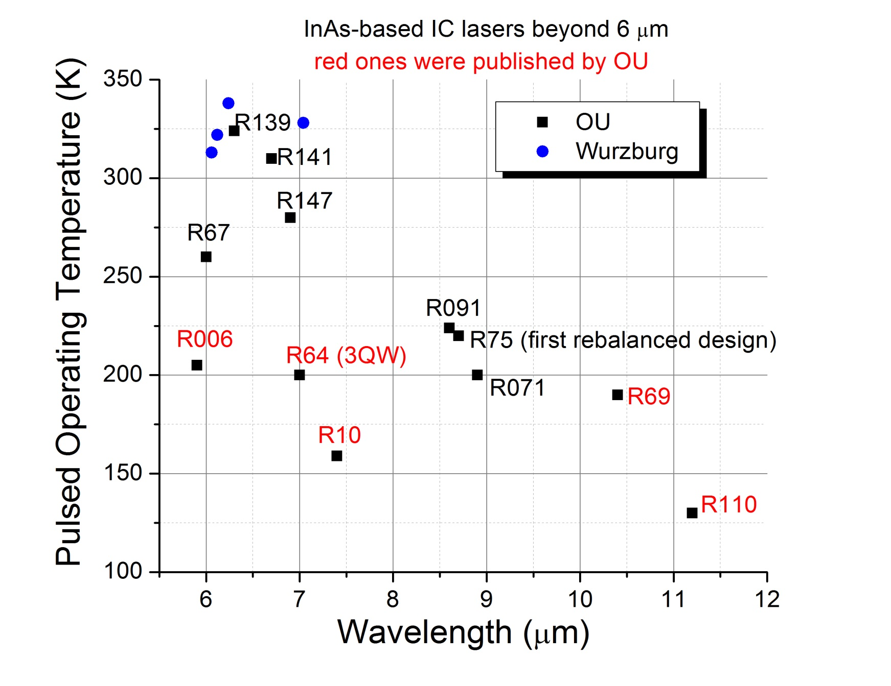
Current status of IC laser at λ> 6μm
CW RT to be achieved soon!

Slide 22
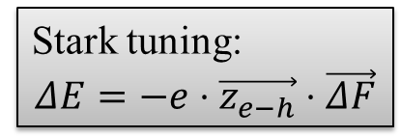
Electrically wide-tunable IC lasers (1)
Why we need wide tuning:
spectroscopy
biochemical analysis
Tuning mechanisms:
Temperature tuning, based on Eg(T) or n(T)
cons: Slow
Grating tuning, such as external-cavity lasers
cons: Cumbersome, lack of long-term stability
Electric field tuning, based on the Stark effect
pros: responsive, convenient
challenge: electric field is difficult to change
after laser reaches threshold
solution: manipulate active region
Stark tuning:
$$ΔE=−e⋅\vec{z_{e−h}}⋅\vec{ΔF}$$
?

Slide 23
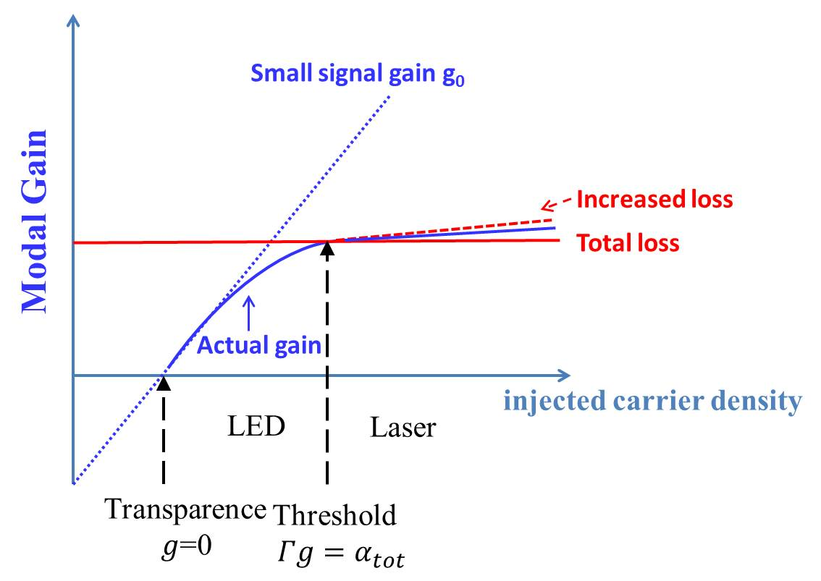
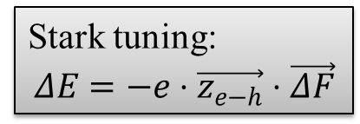
Electrically wide-tunable IC lasers (2)
Stark tuning:
$$ΔE=−e⋅\vec{z_{e−h}}⋅\vec{ΔF}$$
how to change N?
Solution 1:
Create different J_{th} by
multiple sections
Solution 2:
Shift gain-loss balance by
reducing Γ
increasing α

Slide 24
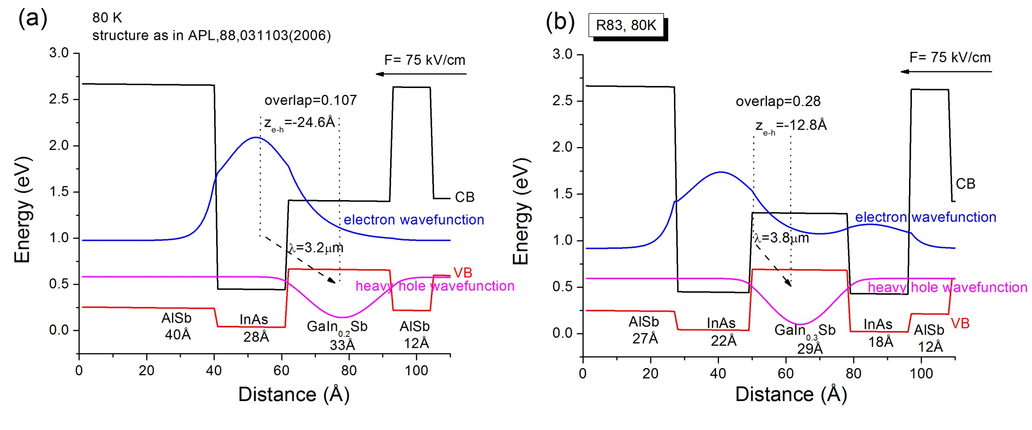
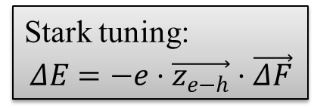
Electrically wide-tunable IC lasers (3)
Stark tuning:
$$ΔE=−e⋅\vec{z_{e−h}}⋅\vec{ΔF}$$
Single QW
Double QWs
Z_{e-h} opposite to electric field direction -> blue-shift Stark tuning

Slide 25
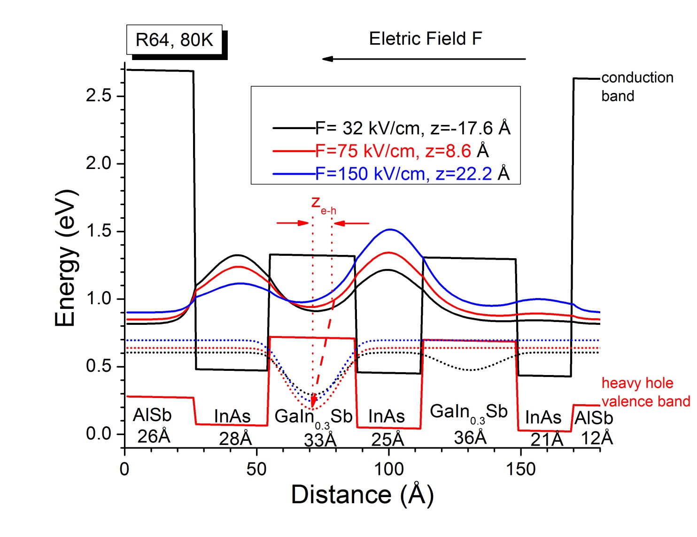

Electrically wide-tunable IC lasers (4)
Triple QWs
Stark tuning:
$$ΔE=−e⋅\vec{z_{e−h}}⋅\vec{ΔF}$$
Z_{e-h} in the same direction with electric field -> red-shift Stark tuning

Slide 26
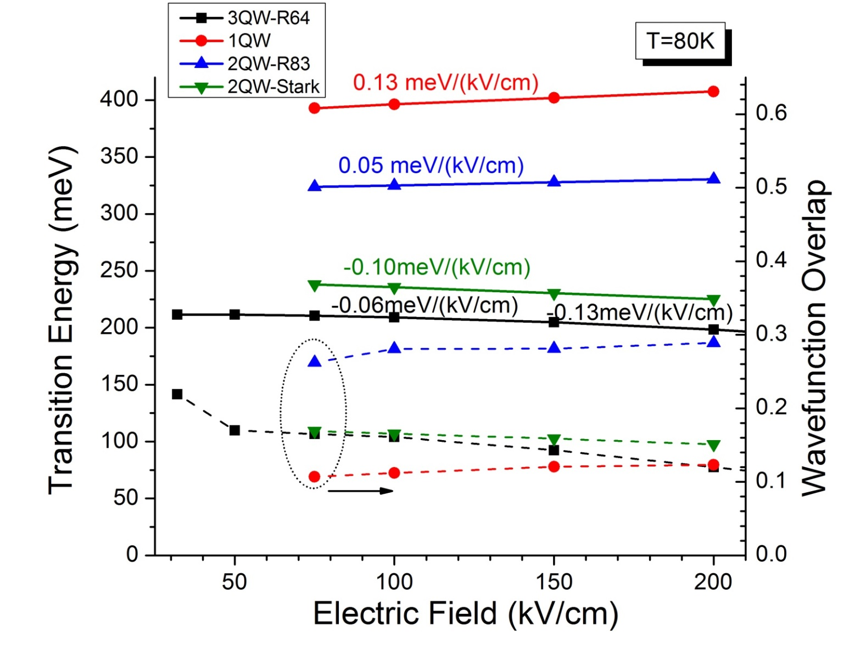
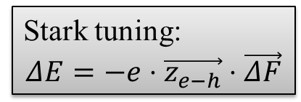
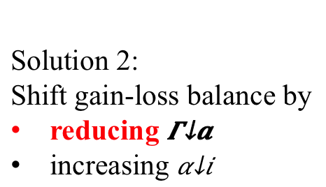
Electrically wide-tunable IC lasers (5)
Stark tuning:
$$ΔE=−e⋅\vec{z_{e−h}}⋅\vec{ΔF}$$
Solution 2:
Shift gain-loss balance by
reducing $Γ_{a}$
increasing $α_{i}$

Slide 27
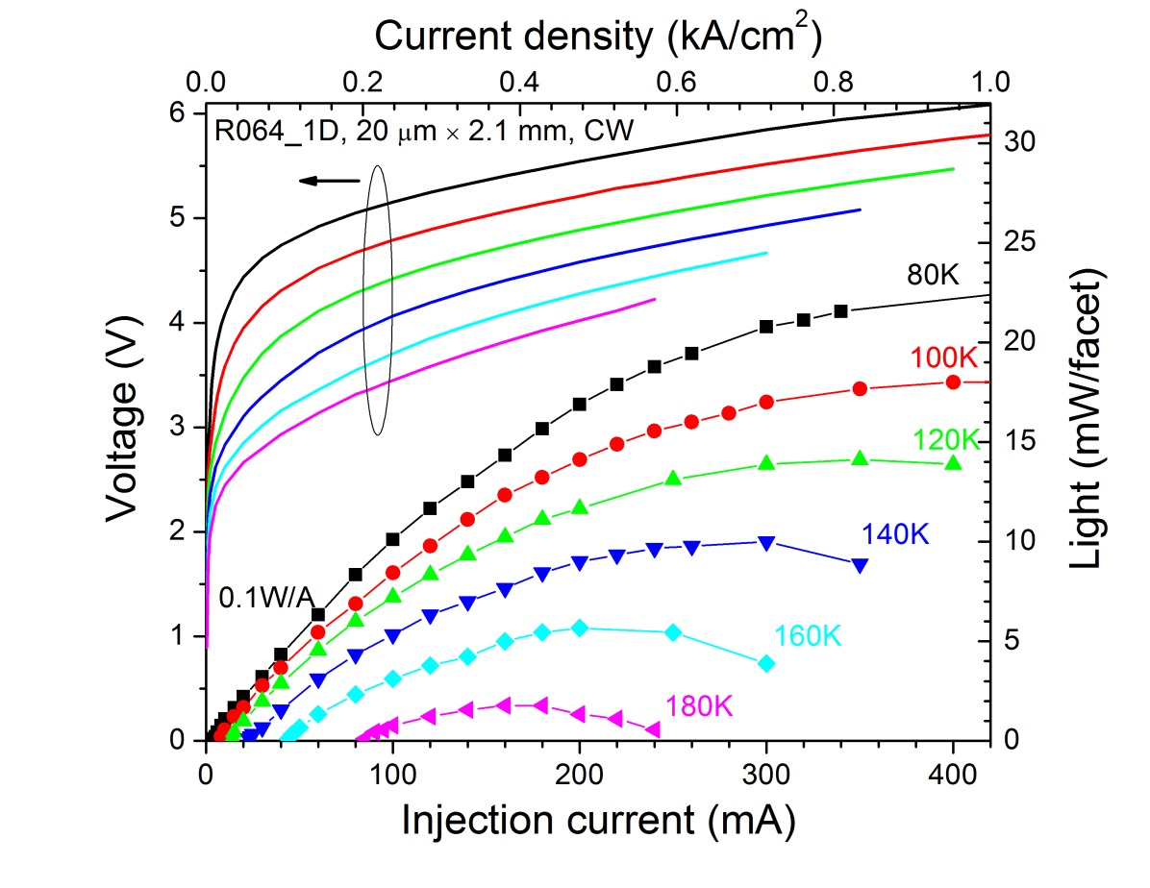
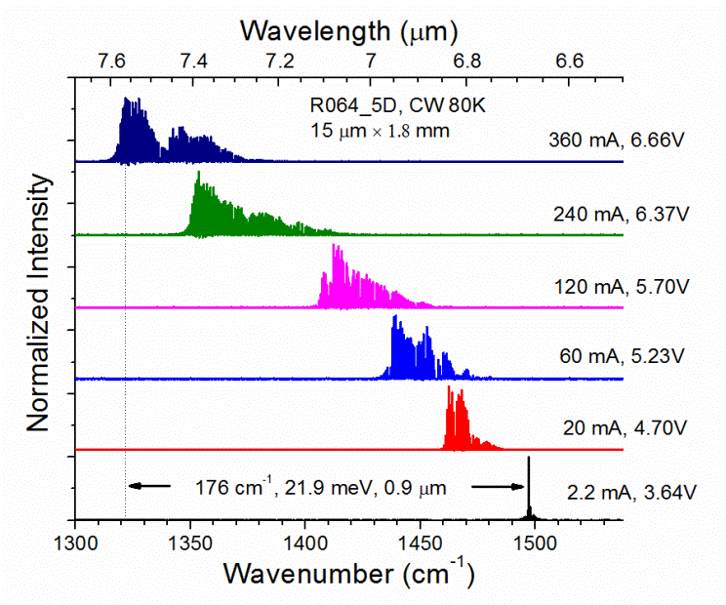
Electrically wide-tunable IC lasers (6)
red-shifted by ~180 cm⁻¹ (22 meV or 900 nm) around λ=7 μm
∆U= 3V, a strong evidence of carrier unpinning
small power efficiency, indicates small differential modal gain and high loss
Y. Jiang, et al., J. Appl. Phys., 115,113101(2014)

Slide 28
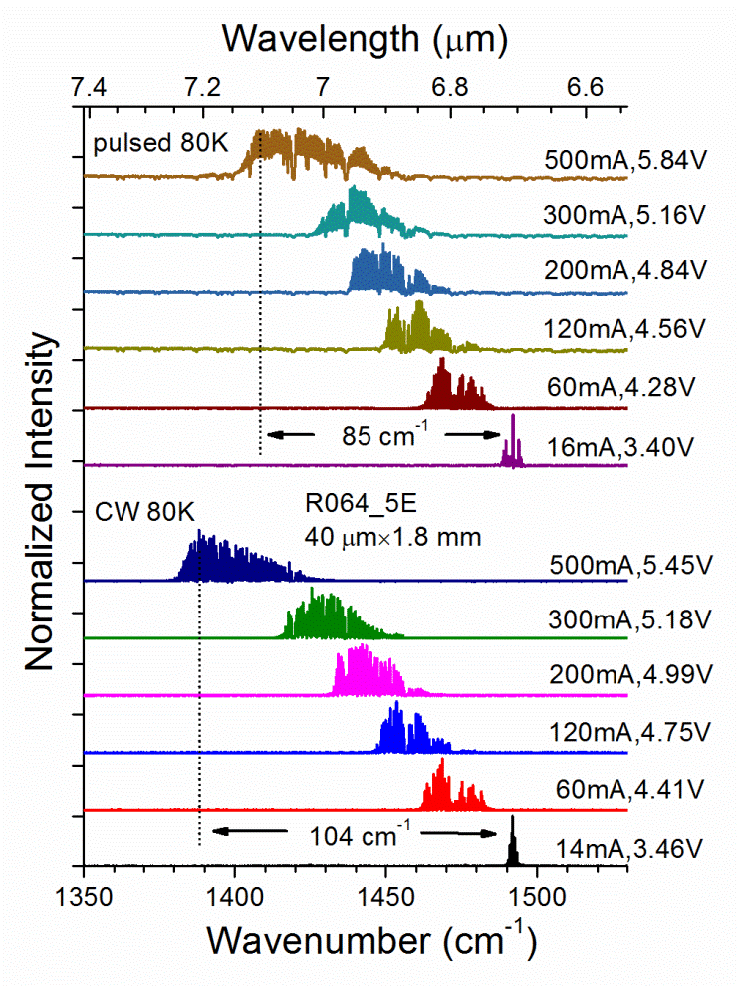
Electrically wide-tunable IC lasers (7)
∆U=2.44 V
Stark effect dominate over heating effect

Slide 29
GaSb-based type-I IC lasers at λ=3.2μm
J_{th}= 300 A/cm² at pulsed 300K
6-stage cascade core, SL waveguide
material grown by NRC of Canada
carrier transition in type-I QW
carrier recycling in type-II QWs
Y. Jiang, et al., Appl. Phys. Lett., 106, 041117(2015)

Slide 30
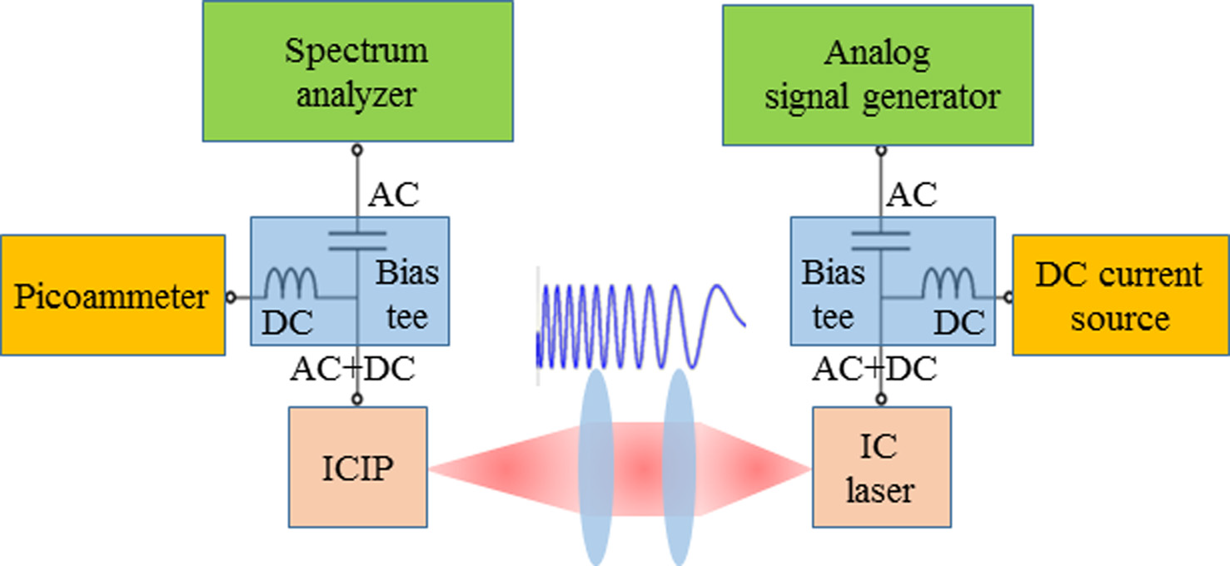
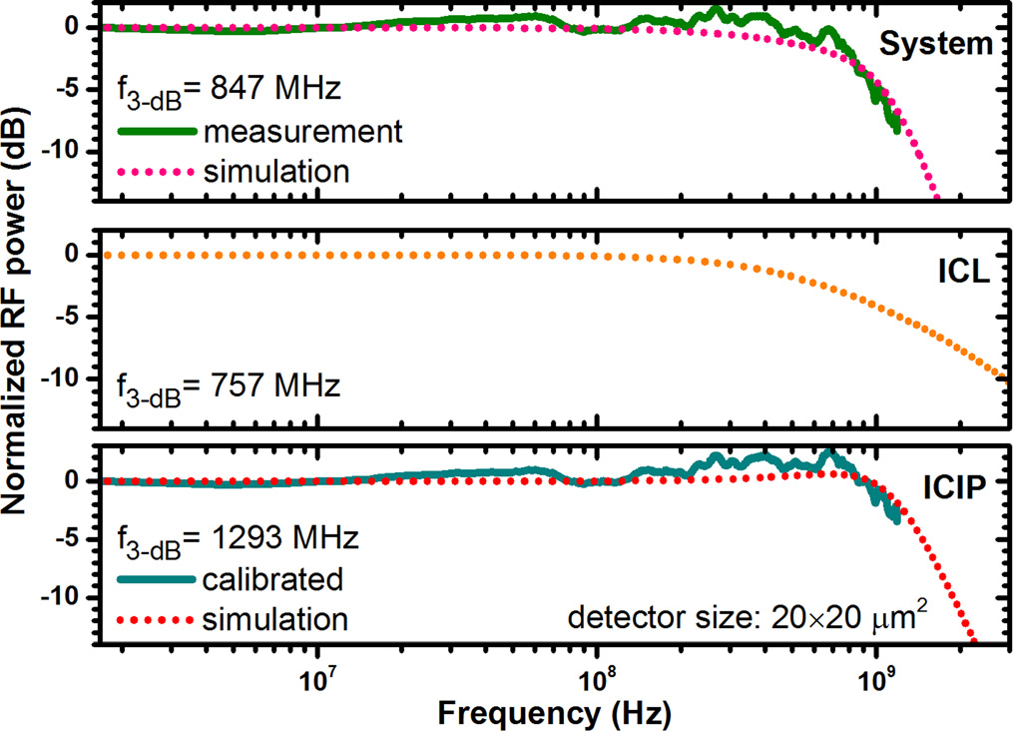
High-speed operation
H. Lotfi, et al., APL, 108, 201101(2016)

Slide 31
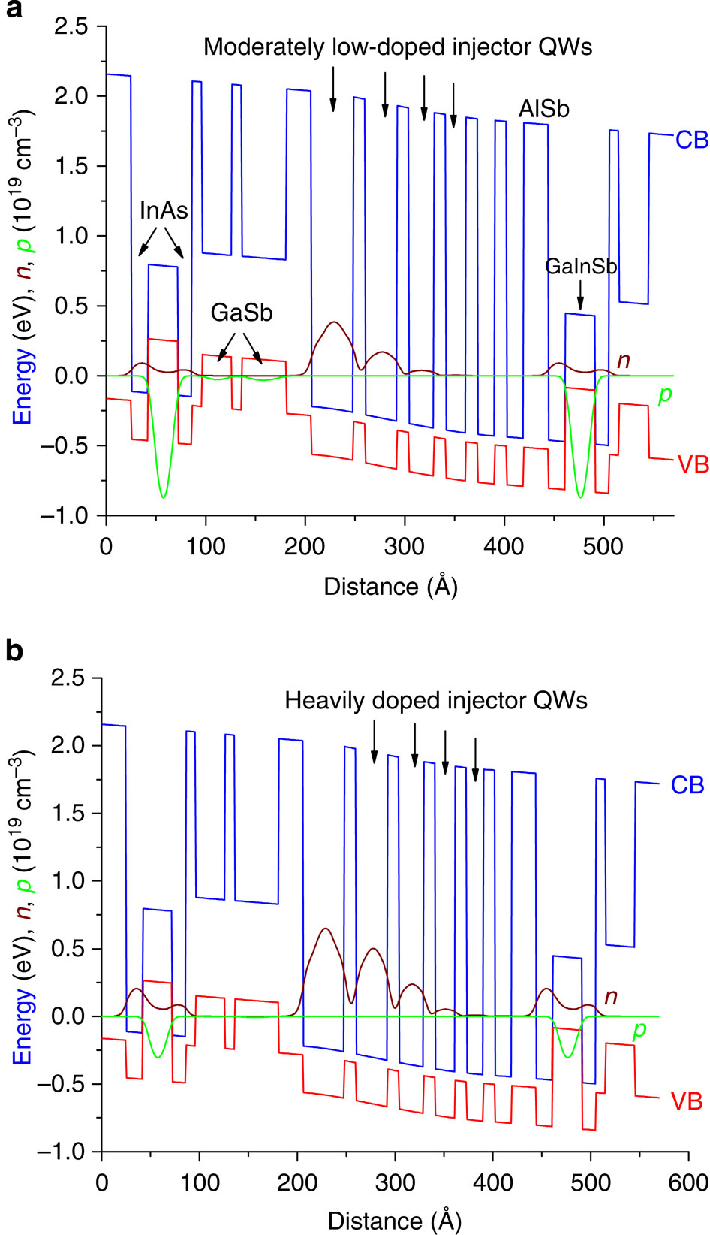
Future work & ideas (1)
Is “carrier rebalancing” true?
is more an experimental finding
explained as electron-hole balance in active region
 | doping | J_{th}
conventional | 4e17 cm⁻³ | 380 A/cm²
innovation | 5e18 cm⁻³ | 167 A/cm²
Not really
scanning voltage microscopy shows the electron
and hole densities are always equal in active region
no matter which doping. [Laser Photon. Rev. 2,224(2015)]
the optimal doping is found by fitting Auger coefficient,
not by more fundamental parameters.
Vurgaftman, et al., Nat. Commun., 2, 585 (2011)

Slide 32
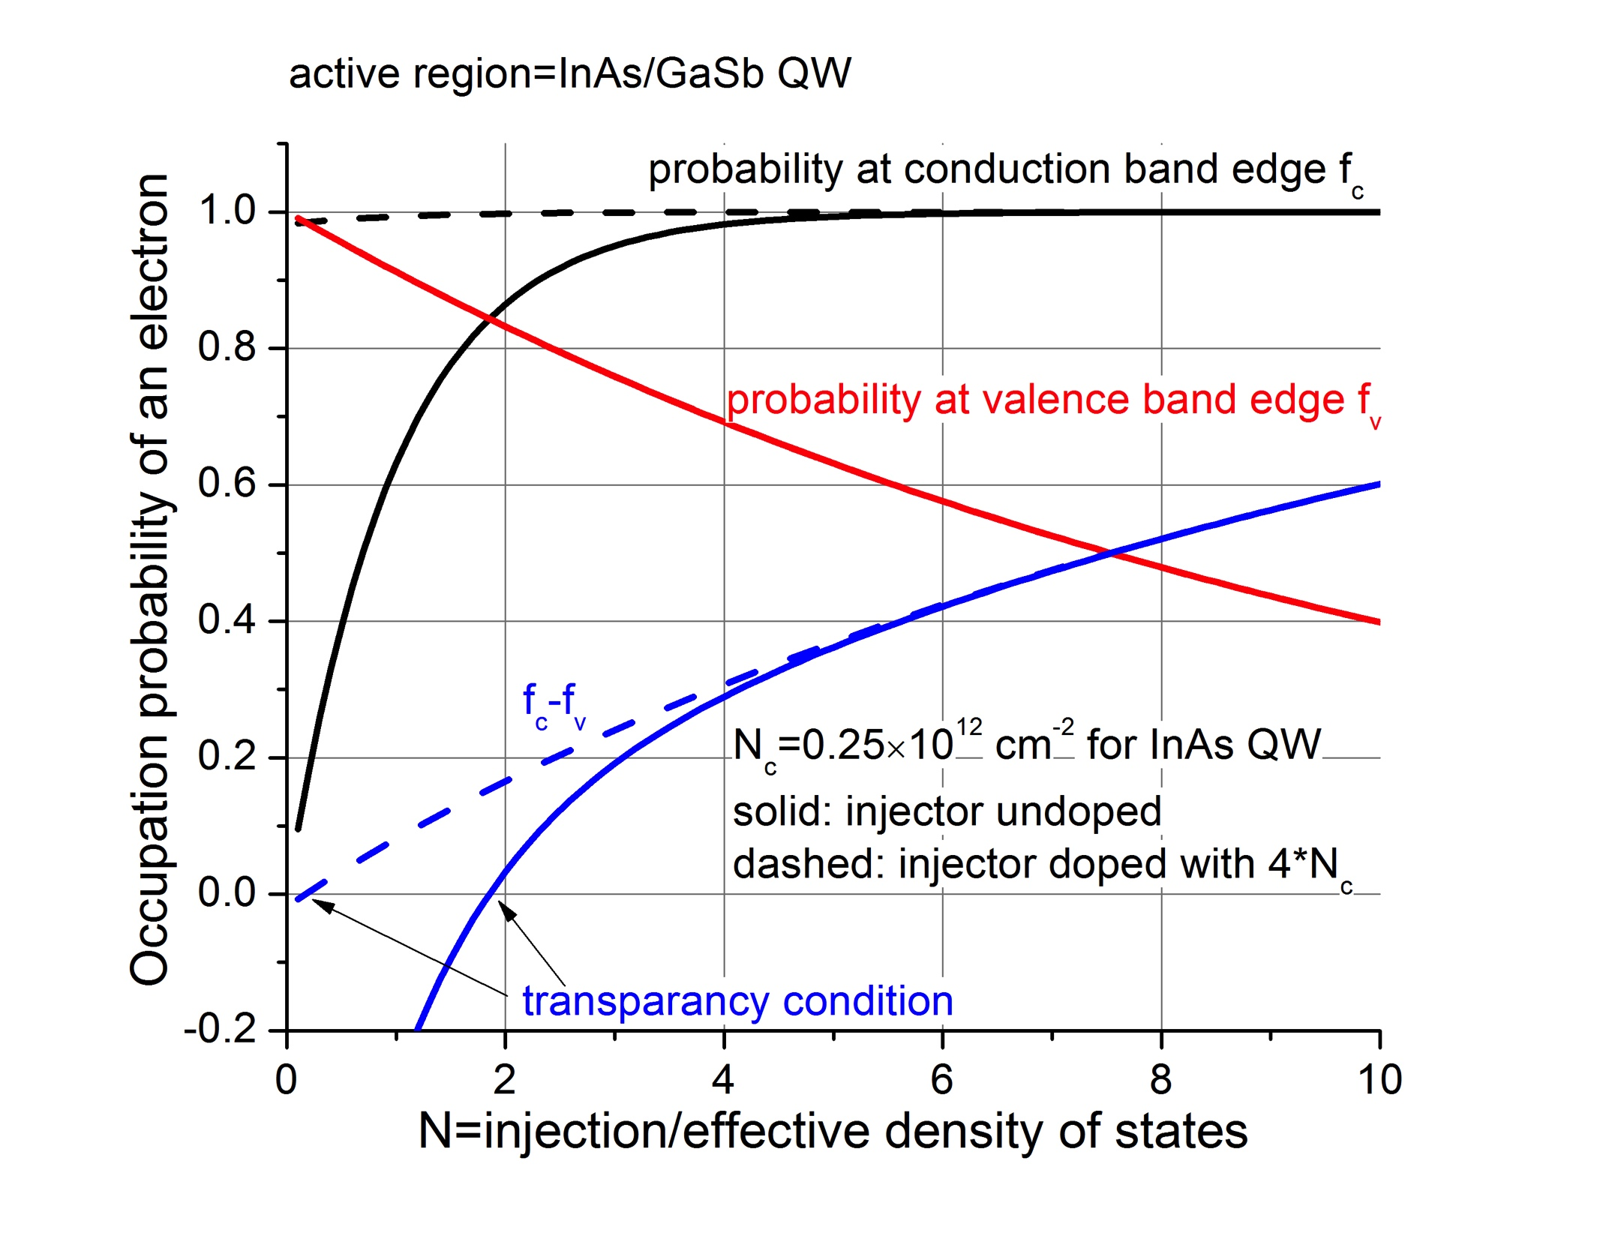
“carrier rebalancing”?
my insights:
It is because the imbalance of
electron and hole effective mass
heavy doping facilitate the Bernard-
Duraffourg inversion condition, so as
reduce transparence carrier density
Optimal doping is on the order of
effective density of states N_{c}
will need more accurate modeling
and systematical experiments to verify
my idea.

Slide 33
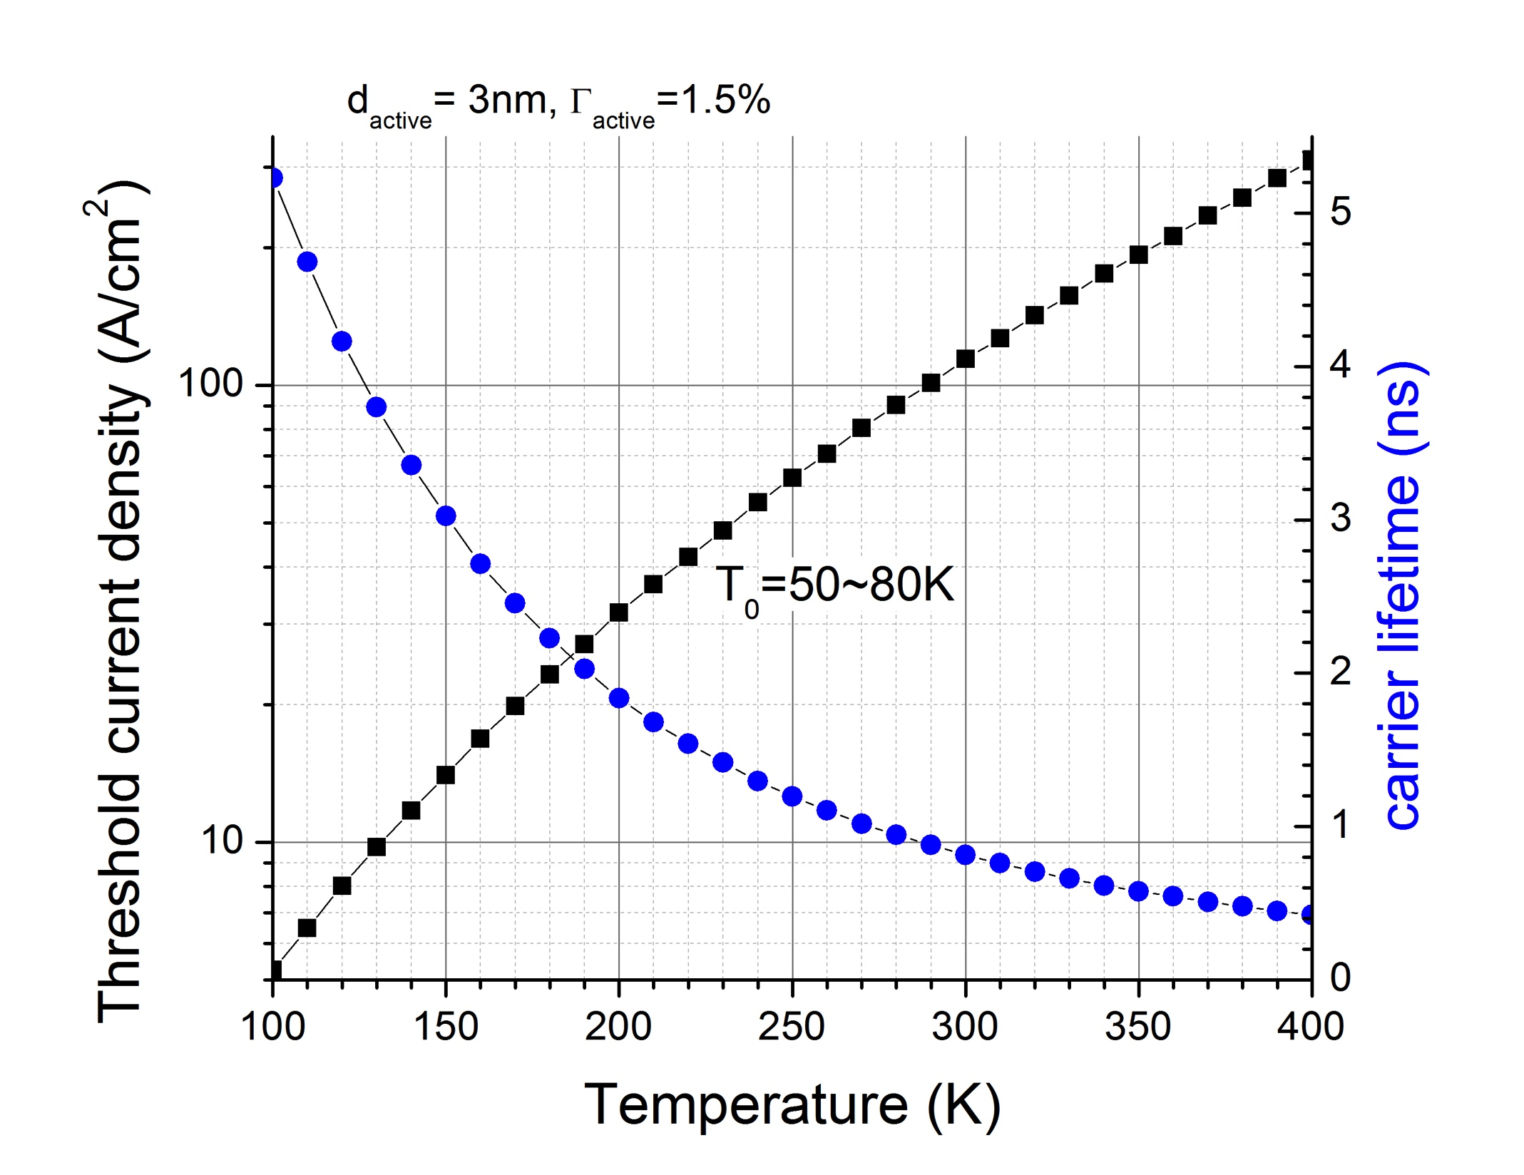
Future work & ideas (2) why small T₀ in most interband lasers?
J_{th}=J₀exp(T/T₀) is widely used to characterize the temperature sensitivity of diode lasers, but T₀ is always much smaller than room temperature.
This affects the practical use of laser. A deeper understanding of the origin of small T0 will be very meaningful.
I have some initial results by:
first principle calculation of
the gain coefficient
empirical data of optical loss
and Auger coefficient
need more complete data to achieve
a more comprehensive model

Slide 34
Future work & ideas (3) why internal efficiency <1 after lasing?
Ideally, carrier density is pinned at threshold level after lasing, so the internal efficiency should be very close to unity.
But in reality, the efficiency is far from unity.
At high injection, the laser stop working, even at pulsed operation.
possible factors:
increased loss
thermal accumulation
carrier leakage

